Slide 1
CAR PRICE PREDICTION MODEL
TEAMS MEMBERS:
Aritra Banerjee
Md. Musharraf
Nilesh Maji
Sujan Banerjee
Shouvik Ghanty
Sounak Kundu
PROJECT MENTOR :
Mr. Supratik Chatterjee
Assistant Professor, Dept. Of CA, Asansol Engineering College

Slide 2
Project Objective & Scope
Data Description
Methodology
Data Preprocessing
Models Used
Accuracy Comparison
Future Scope of Improvements
CONTENTS

Slide 3
PROJECT OBJECTIVE & SCOPE
Objective:
Given: A used car dataset from Kaggle with features like year, km driven, fuel type, transmission, etc.
Goal: Predict the selling price of a used car using machine learning models.
Finally: Evaluate different regression models and deploy the best one using a Streamlit web app.
Scope:
Helps users estimate a fair price for used cars without dealer dependency.
Demonstrates regression techniques in real-world prediction tasks.
Predictions may vary for unusual or rare listings.
Model performance can improve with more data and regular updates.

Slide 4
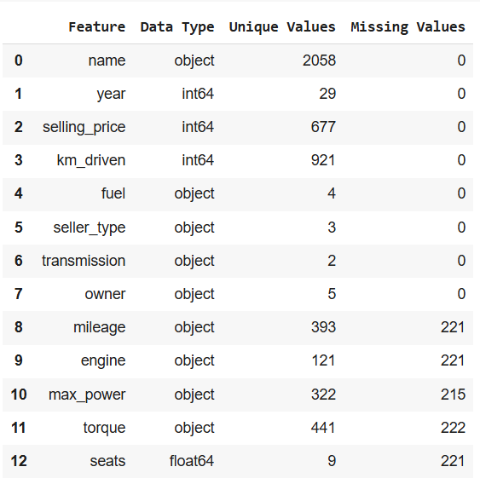
DATA DESCRIPTION

Slide 5
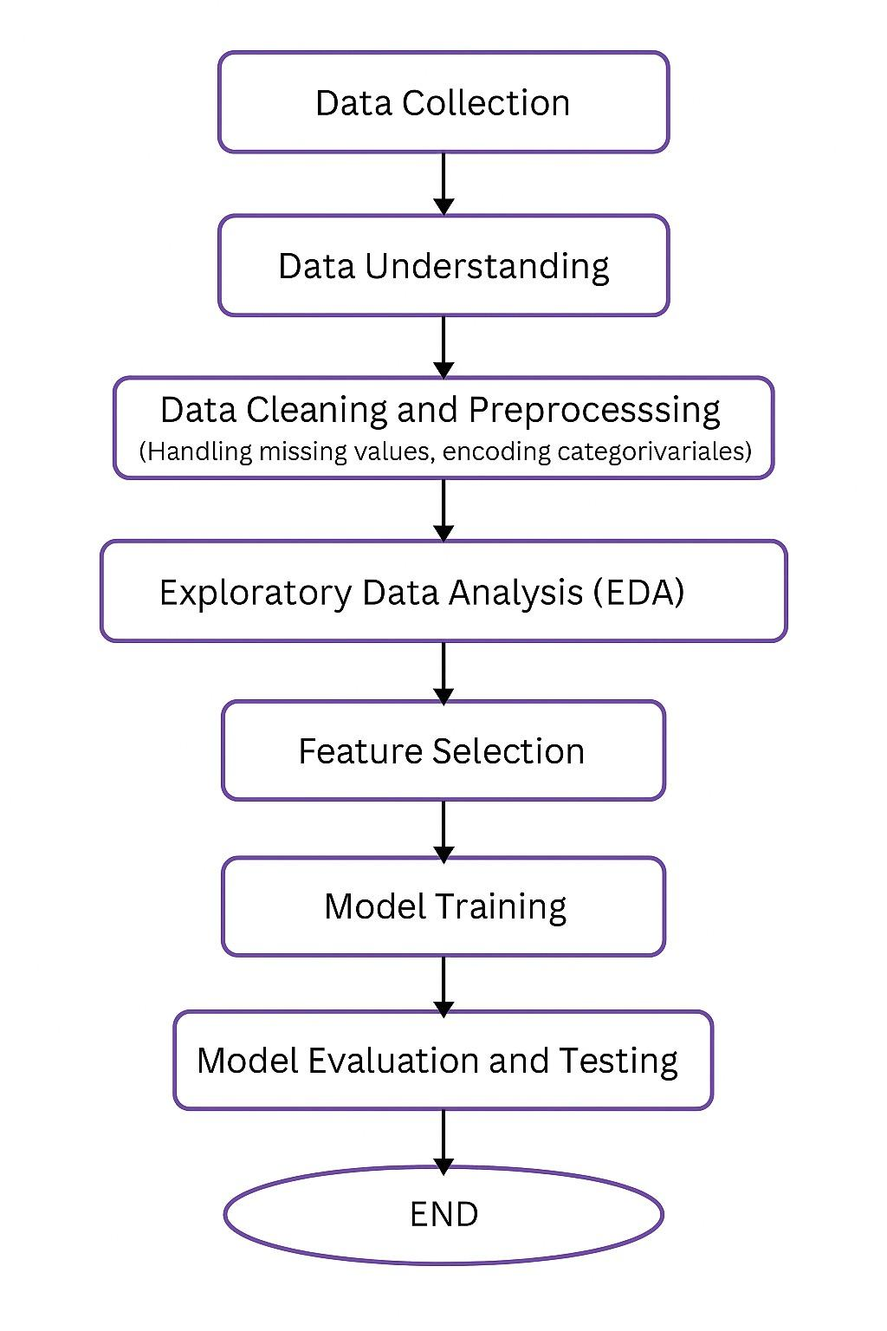
METHODOLOGY

Slide 6
DATA PREPROCESSING
Missing Values
Checked using .isnull().sum()
Dropped rows with nulls in key columns
Categorical to Numeric
Applied One-Hot Encoding on features like Fuel, Transmission, Owner
Feature Scaling
Used StandardScaler to normalize numeric columns
Outlier Handling
Removed extreme values in price and kilometers driven
Feature Selection
Dropped irrelevant columns (e.g., unnamed or duplicate features)

Slide 7
MODELS USED
The Machine Learning models used for this project are:
Linear Regression
Decision Tree
Random Forest
Gradient Boosting
XGBoost
K-NN

Slide 8
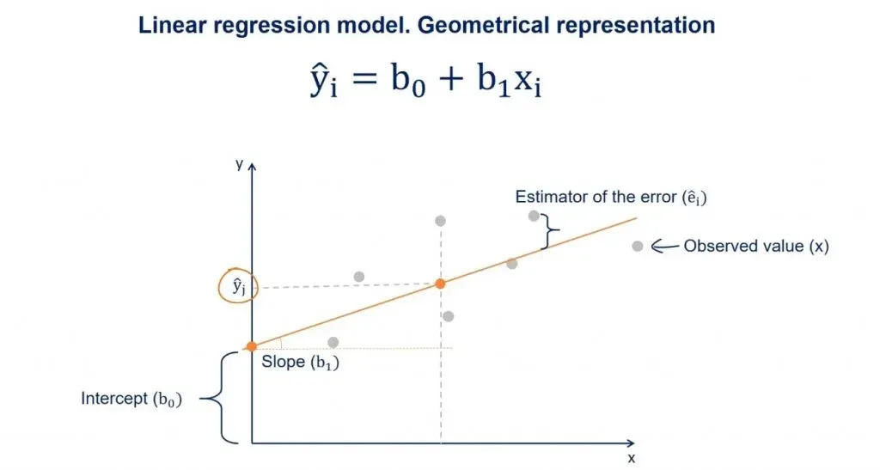
LINEAR REGRESSION
Linear Regression is a simple and commonly used supervised machine learning algorithm used for predicting a continuous output based on one or more input features.
It assumes a linear relationship between the input variables (X) and the output variable (Y), and tries to fit a straight line that best represents this relationship.
In our project, Linear Regression was used to predict the car selling price using features like year, kilometers driven, fuel type, and more.

Slide 9
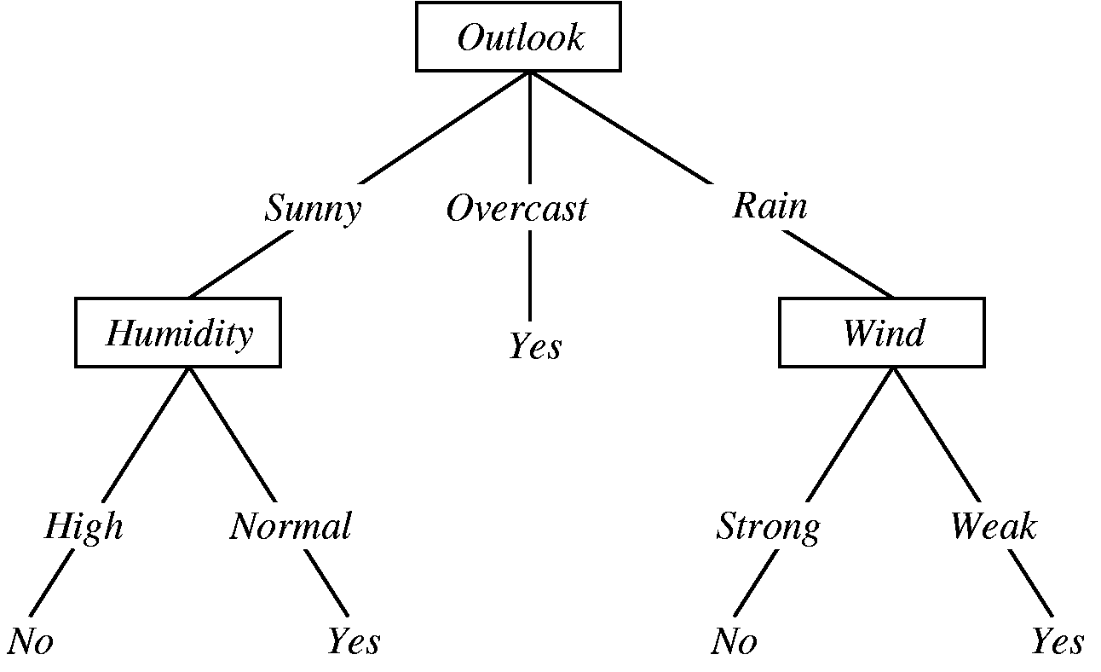
DECISION TREE
Decision Tree Regression is a supervised learning algorithm used for predicting continuous values by learning simple decision rules inferred from the data features.
It works like a flowchart, where each internal node represents a decision on a feature, each branch represents the outcome, and each leaf node represents a predicted value.
In our project, the Decision Tree model helped to capture non-linear patterns in the data and make price predictions based on feature-based conditions.

Slide 10
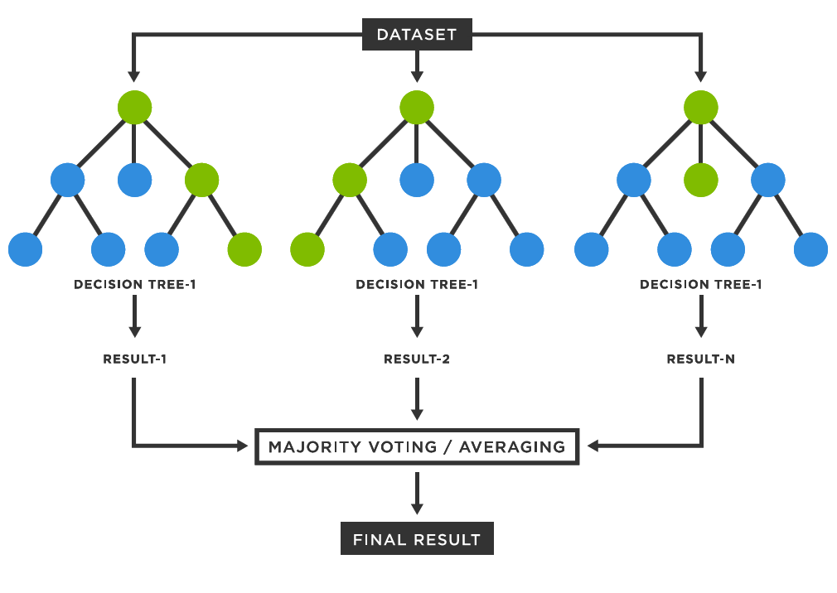
RANDOM FOREST
Random Forest is an ensemble learning method that builds multiple decision trees and merges their results to improve prediction accuracy and reduce overfitting.
It uses a technique called bagging (Bootstrap Aggregating), where each tree is trained on a random subset of the data, and the final prediction is the average of all tree predictions.
In our project, Random Forest provided the best overall accuracy and performance metrics, making it the primary model for predicting used car prices.

Slide 11
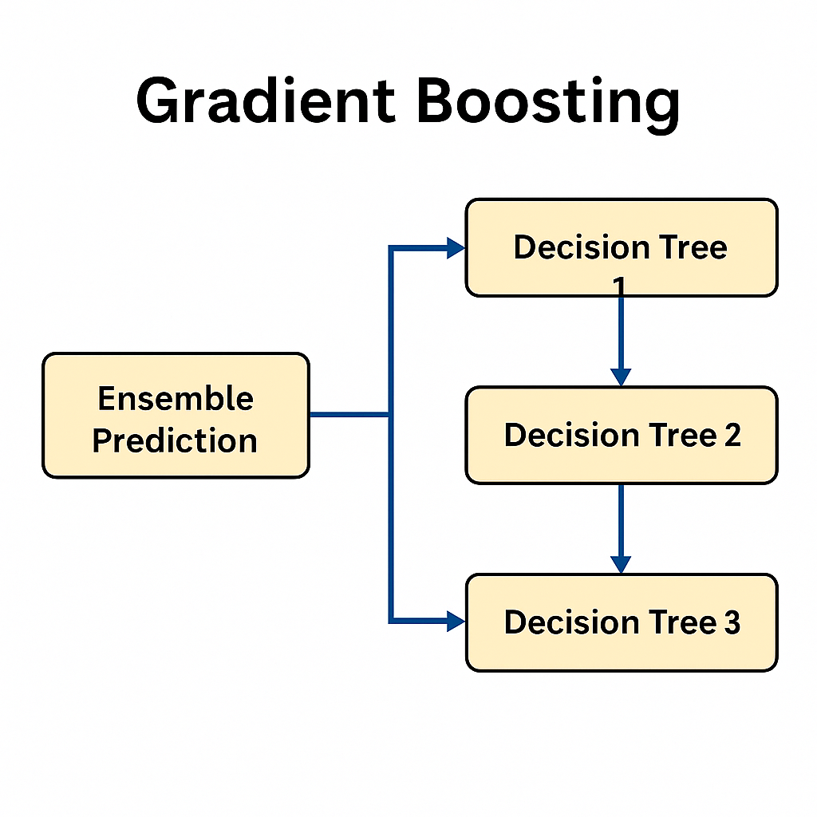
GRADIENT BOOSTING
Gradient Boosting is a powerful ensemble technique that builds models sequentially, where each new model tries to correct the errors made by the previous ones.
It uses a method called boosting, where weak learners (typically shallow decision trees) are combined to form a strong predictive model.
Unlike Random Forest which builds trees in parallel, Gradient Boosting focuses on minimizing the residual errors step by step using gradient descent.

Slide 12
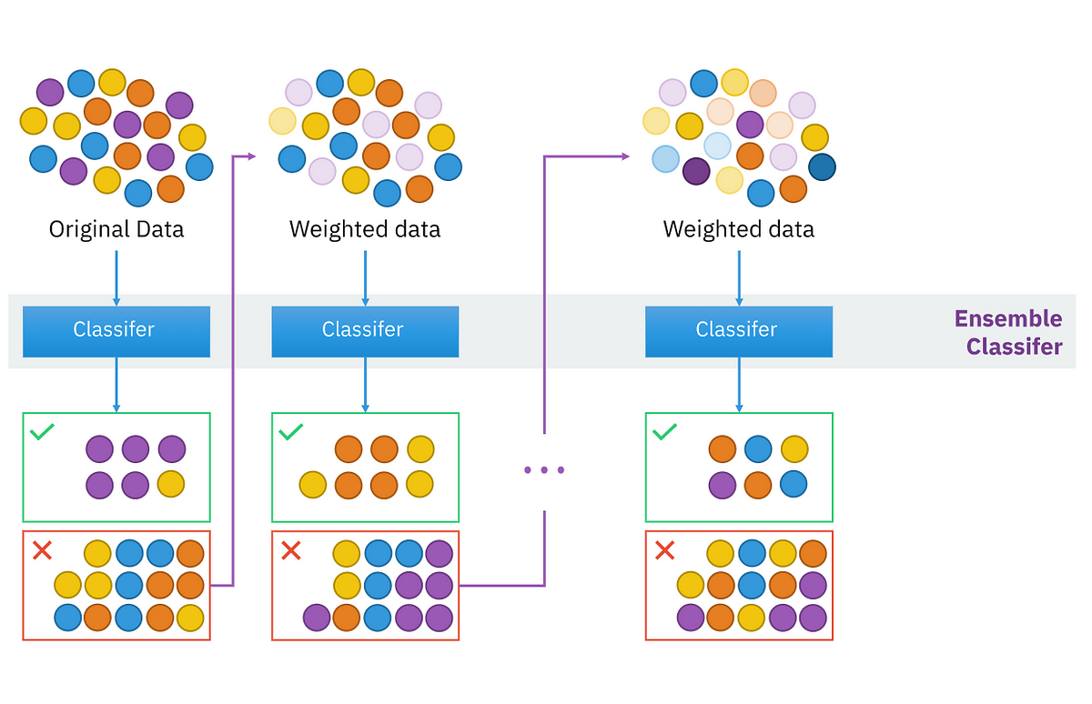
XGBOOST
Gradient Boosting is a powerful ensemble technique that builds models sequentially, where each new model tries to correct the errors made by the previous ones.
It uses a method called boosting, where weak learners (typically shallow decision trees) are combined to form a strong predictive model.
In our project, Gradient Boosting achieved high accuracy and worked well on the dataset, although it was slightly less consistent compared to Random Forest.

Slide 13
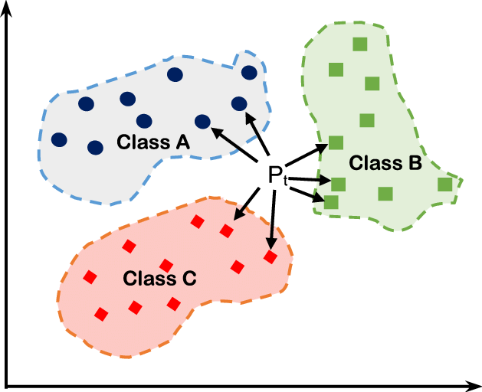
KNN
KNN is a simple, instance-based learning algorithm used for classification and regression tasks.
It makes predictions by finding the ‘K’ closest data points in the training set and taking the average (for regression) or majority vote (for classification).
It does not build an explicit model but relies on distance metrics (like Euclidean distance) to make predictions.
KNN can be computationally expensive for large datasets.

Slide 14
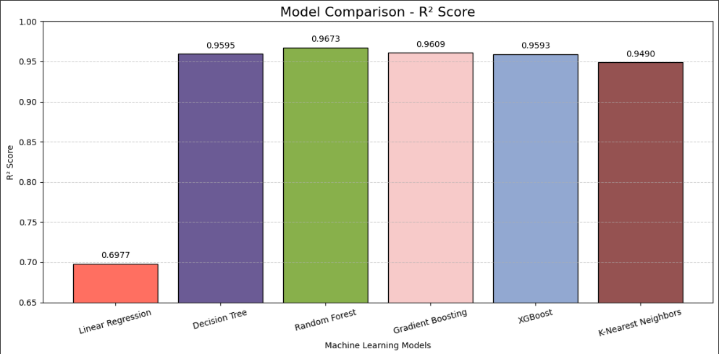
ACCURACY COMPARISON

Slide 15
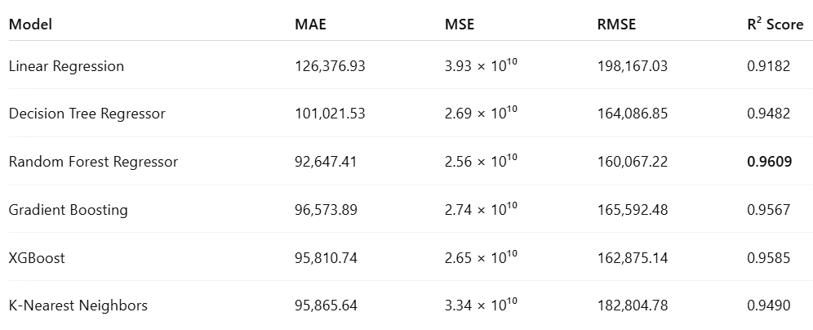
ACCURACY COMPARISON (CONTD.)

Slide 16
FUTURE SCOPE OF IMPROVEMENTS
Deployment: The application can be deployed on platforms like Heroku, Render, or AWS to make it publicly accessible and usable by a wider audience.
Model Optimization: Experimenting with advanced models like CatBoost or ensemble stacking could improve predictive performance.
Larger Dataset: Train the models on a more diverse and extensive dataset to improve generalizability to real-world used car markets.
Real-Time Predictions: Deploy the model into a live web application where users can input car details and get instant price predictions.
Mobile App Integration: Extending the platform to Android/iOS would increase accessibility and usability.

Slide 17
THANK YOU!

